Slide 1

CSE 591
Computer Visualization
Milestone 3
A Story Behind GDP
Jiaqi He, Yezhuo Zhu, Ersi Zha

Slide 2
Data Selection
Data Field | Detail Items
GDP | GDP Gross GDP annual growth GDP per capita
Rural and Urban Development | Urban population GDP composition
Education | School Enrollment Rate for Primary School Enrollment Rate for Secondary School Enrollment Rate for Tertiary
Health | Life Expectancy, Improved Sanitation Facilities, Health Expenditure , Population Composition
Infrastructure | Mobile Cellular Subscription, Internet users
Data Source:
WorldBank Organization
http://data.worldbank.org/

Slide 3
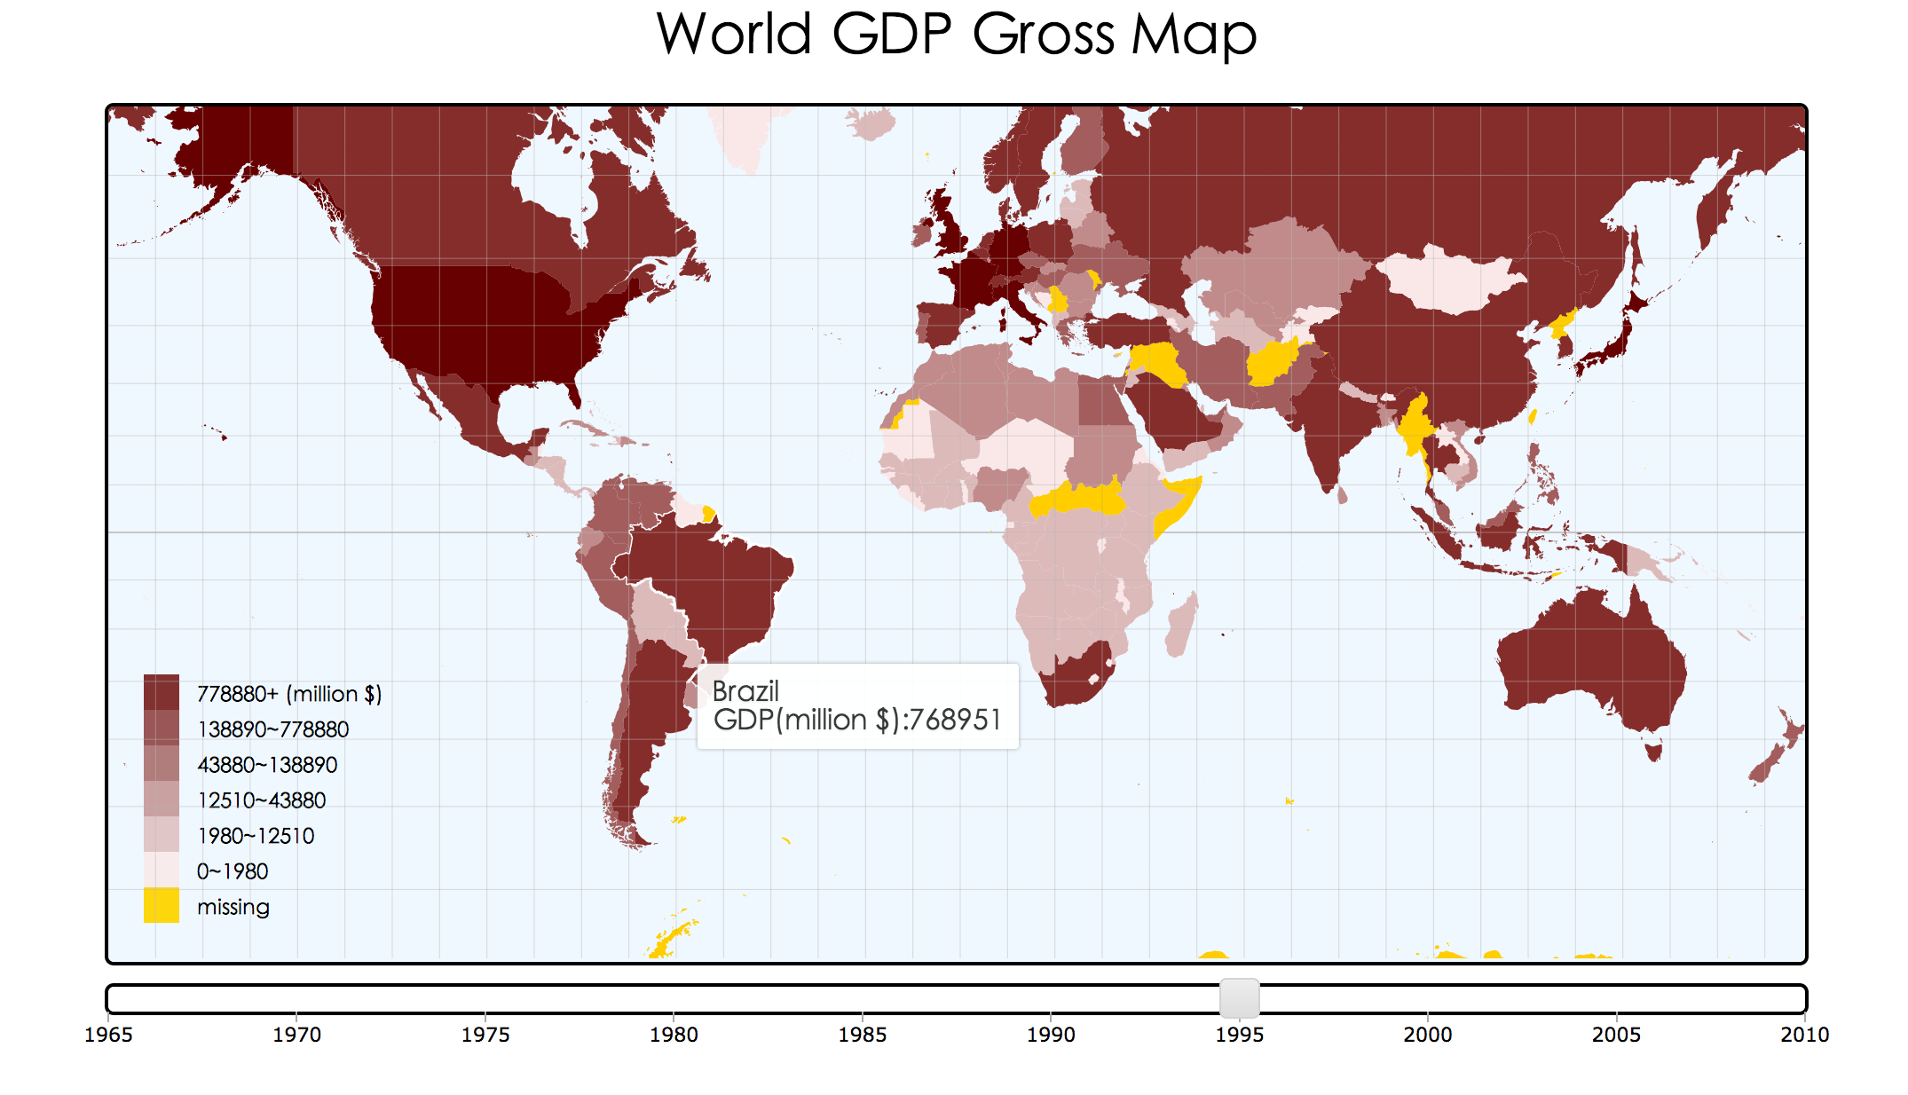
Overview
Choropleth Map: GDP of worldwide countries

Slide 4
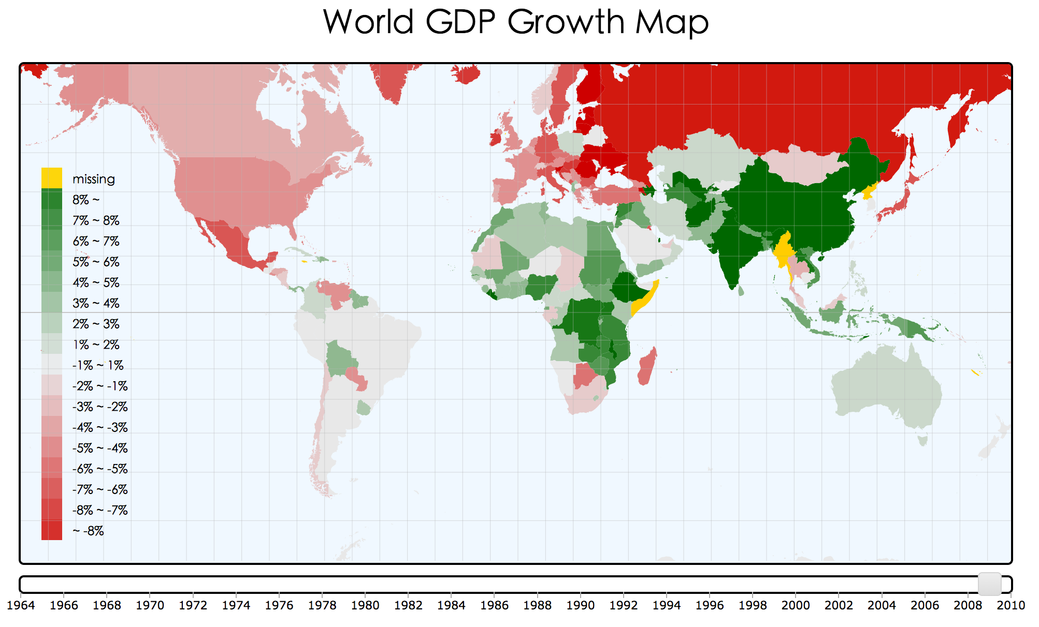
Overview
Choropleth Map: GDP of annual growth of worldwide countries

Slide 5
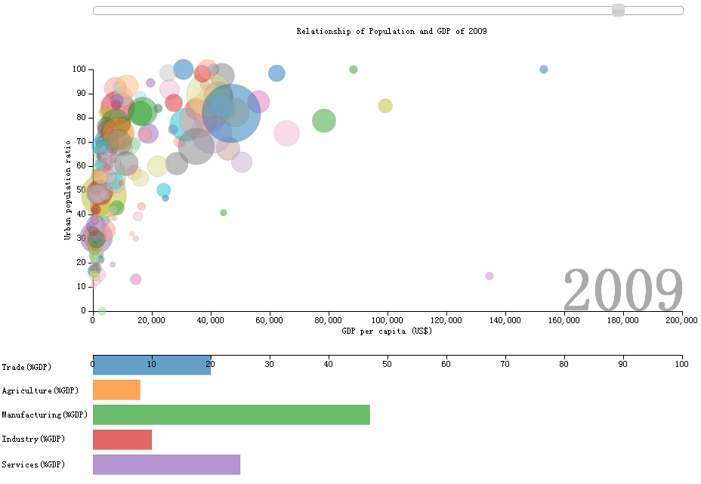
Overview
Scatter Plot: Urban population ratio and GDP per captia
Histogram: Composition of GDP

Slide 6
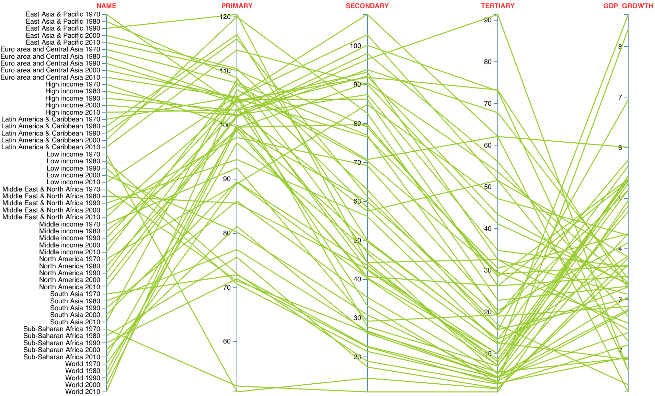
Overview
Parallel Coordinates Plot: School Enrollment Rate

Slide 7
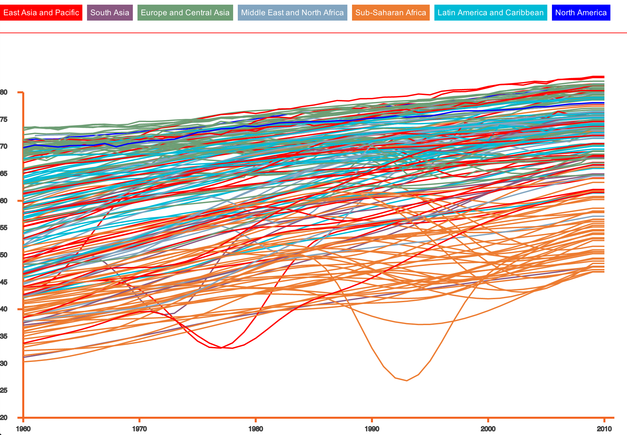
Overview
Line Chart: Life Expectancy

Slide 8
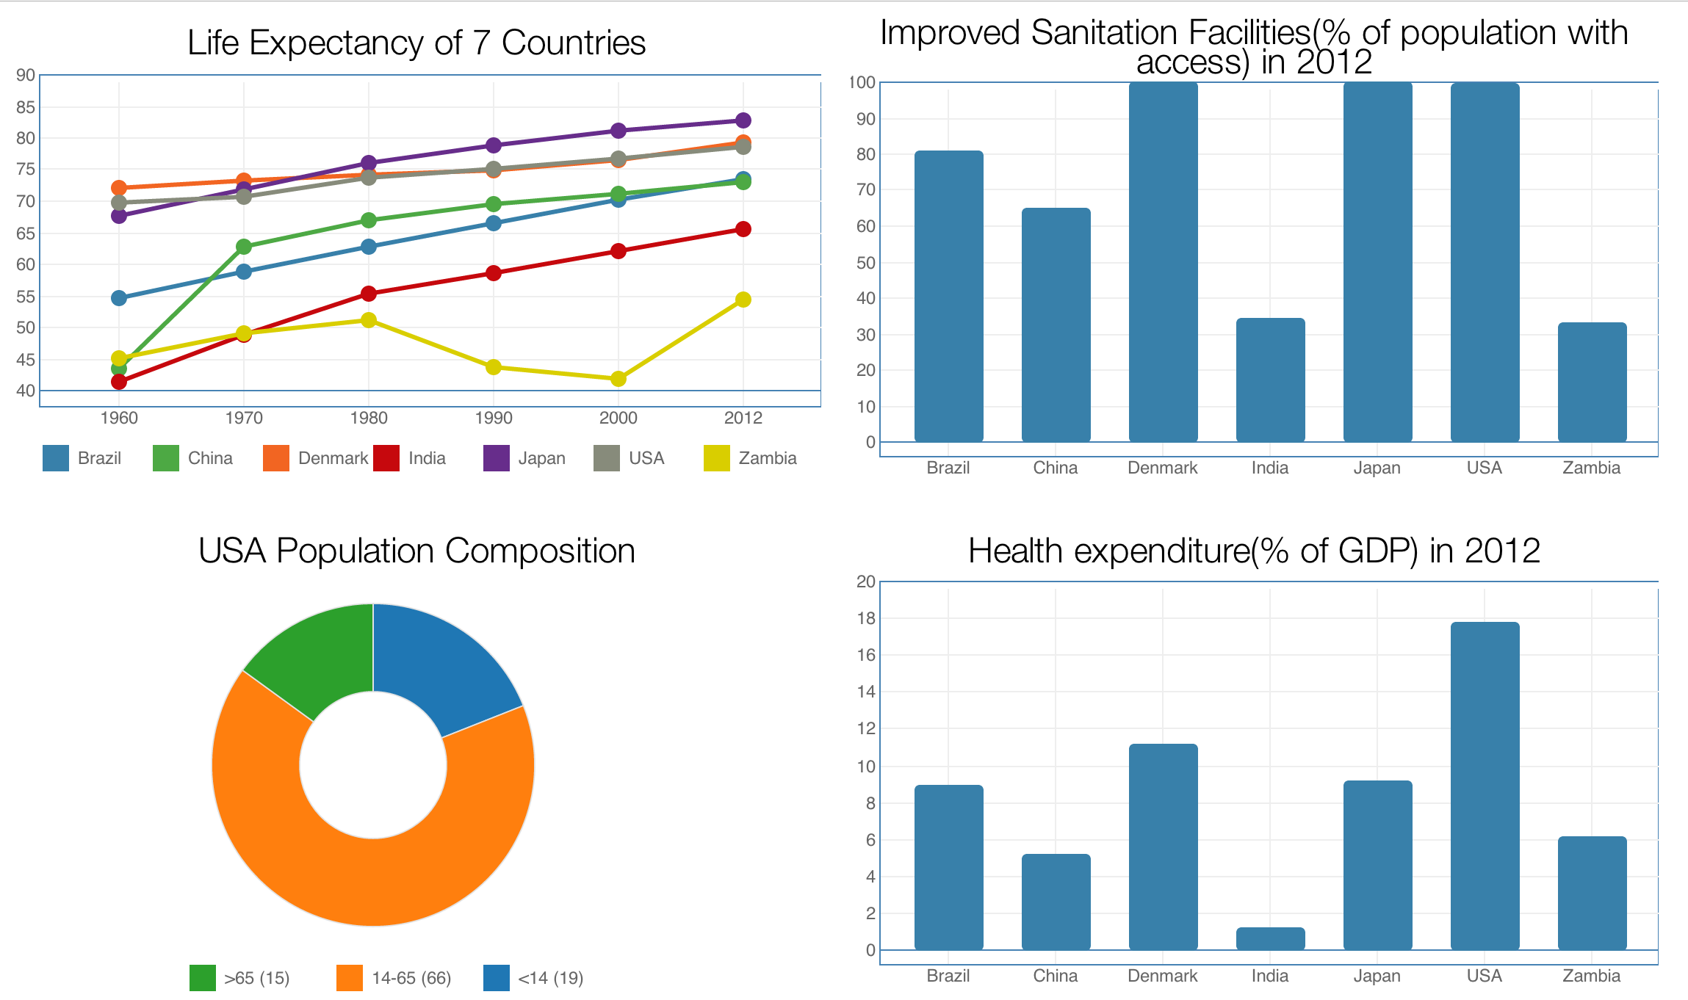
Overview
Histogram,Line Chart&&Pie Chart: Health status of 7 major countries

Slide 9
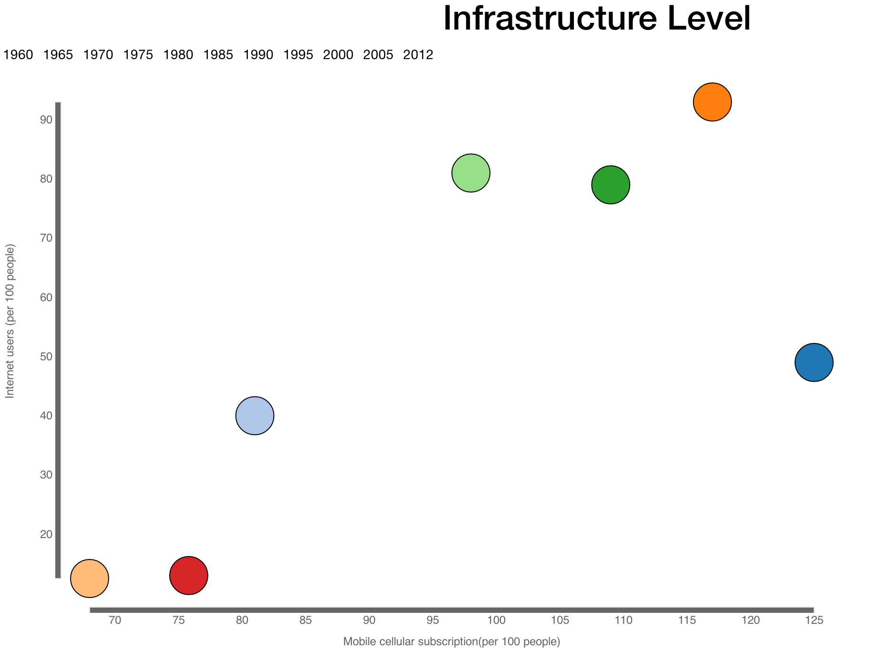
Overview
Scatter Plot: Infrastructure level of 7 major countries

Slide 10
Choropleth of GDP
Quantile Classification
Sequential Color Scheme
Tooltip
Zoom in and Zoom out
Timeline Slider
Drag and Move

Slide 11
Choropleth of GDP Annual Growth
Equal Interval Classification
Diverging Color Scheme
More Years’ Data
More Expressive

Slide 12
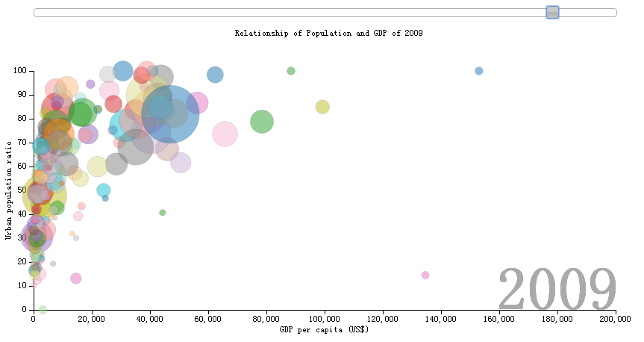
This Scatter Plot shows the relationship of Urban population ratio and GDP per capita.
The higher is GDP per capita, the higher is Urban population ratio.
For China, India and Brazil, though GDP increase fast and urban population ratio also increase, GDP per capita still keep low.
For USA, Japan and Denmark, GDP per capita and Urban population ratio keeps higher level.
For Liechtenstein, the urban population ratio is lower but GDP per capita is very high.
Scatter Plot
Relationship of Urban population ratio
and GDP per capita

Slide 13
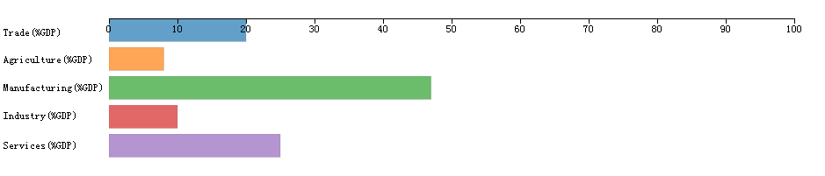
Histogram: Composition of GDP
The composition of GDP, is there any relationship among composition of GDP, GDP per capita and Urban population ratio?

Slide 14
How about the distribution of GDP compositions of developing countries such as China, India and Brazil?
How about the distribution of GDP compositions of developed countries such as U.S.A, Japan and Denmark?
Why do some countries have higher GDP per capita but lower urban population ratio?
Explore the relationship

Slide 15
Parallel Coordinates Plot Of School Enrollment Rate
Primary School Enrollment Rate =
total enrollment in primary education/
total population of primary
education age.
From 1970-2010, divided worldwide
countries into 7 regions:
South Asia
East Asia & Pacific
Europe and Central Asia
(4) Middle East & North Africa
(5) Sub-Saharan Africa
(6) Latin America & Caribbean
(7) North America
Each line represents the data of a region in a particular year

Slide 16
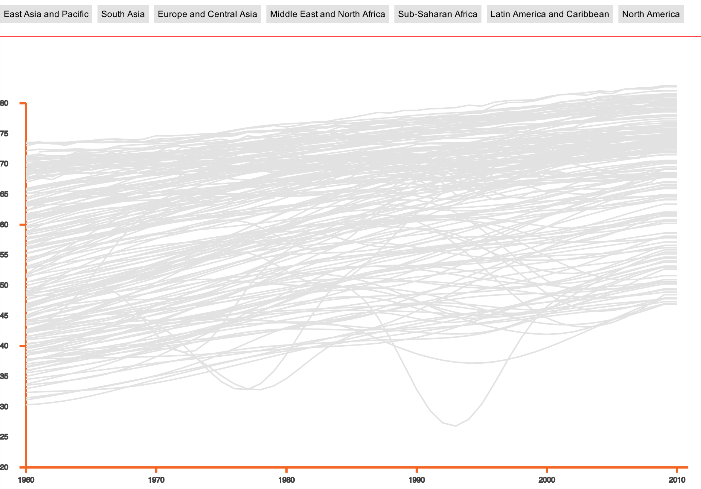
Line Chart of Life Expectancy
Worldwide Countries
X-axis: years ,Y-axis:life expectancy
From 1960-2010, divided
worldwide countries into 7 regions
South Asia
East Asia & Pacific
Europe and Central Asia
(4) Middle East & North Africa
(5) Sub-Saharan Africa
(6) Latin America & Caribbean
(7) North America

Slide 17
Line Chart of Life Expectancy
Worldwide Countries
South Asia
East Asia & Pacific
Europe and Central Asia
(4) Middle East & North Africa
(5) Sub-Saharan Africa
(6) Latin America & Caribbean
(7) North America
Each color represents a region, it’s
interesting to see the distribution of
different of regions in the world,

Slide 18
Health status of 7 countries
1960- 2012:
1.Life Expectancy
2.Improved Sanitation Facilities
3.Health Expenditrue
4.Population Compsition

Slide 19
Scatter Plot: Infrastructure Level
1960- 2012:
(Brazil, China, Denmark
, India, Japan, USA, Zambia)
X-axis: Mobile Cellular Subscription
(per 100 people)
Y-axis: Internet Users
(per 100 people)
Each bubble represents a county

Slide 20
Thank you for listening!
Q&A

